Slide 1
Today’s Class
6:00PM – 8:00PM: Data Visualization with ggplot2
8:15AM – 9:00PM: Movie Challenge
9:00PM – 9:50PM: Coding exercise

Slide 2
visualization
Visualize
Get
Clean
Transform
Communicate
Model
Understand
Program
☨A modified version of Hadley Wickham’s analytic process

Slide 3
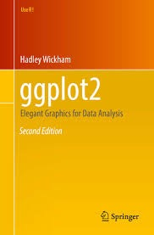
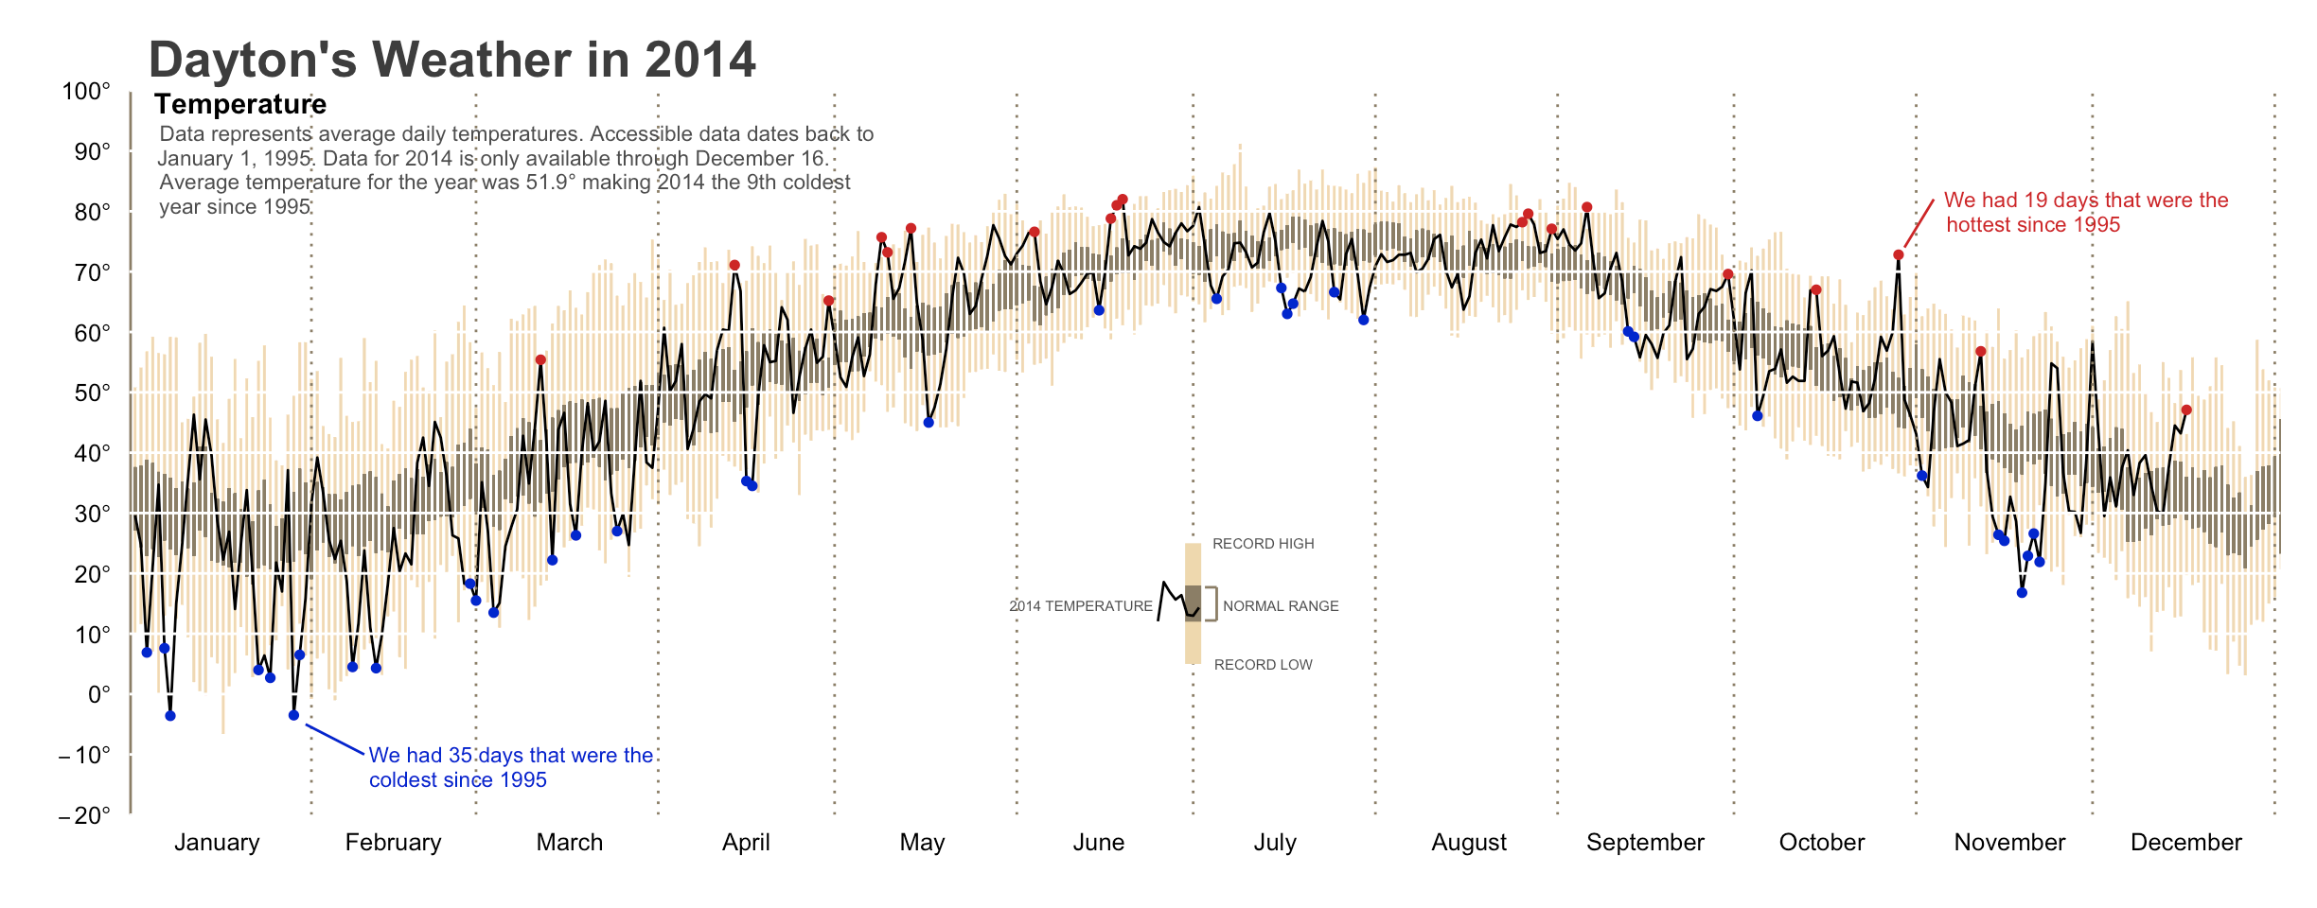
ggplot2
R has several systems for making graphs
ggplot2 is the most elegant and versatile
Implements the grammar of graphics theory behind data visualization

Slide 4

prerequisites

Slide 5
package prerequisite
library(tidyverse)
#> Loading tidyverse: ggplot2
#> Loading tidyverse: tibble
#> Loading tidyverse: tidyr
#> Loading tidyverse: readr
#> Loading tidyverse: purrr
#> Loading tidyverse: dplyr
#> Conflicts with tidy packages ----------------------------------------------
#> filter(): dplyr, stats
#> lag(): dplyr, stats

Slide 6
data prerequisite
mpg
#> # A tibble: 234 × 11
#> manufacturer model displ year cyl trans drv cty hwy fl
#> <chr> <chr> <dbl> <int> <int> <chr> <chr> <int> <int> <chr>
#> 1 audi a4 1.8 1999 4 auto(l5) f 18 29 p
#> 2 audi a4 1.8 1999 4 manual(m5) f 21 29 p
#> 3 audi a4 2.0 2008 4 manual(m6) f 20 31 p
#> 4 audi a4 2.0 2008 4 auto(av) f 21 30 p
#> 5 audi a4 2.8 1999 6 auto(l5) f 16 26 p
#> 6 audi a4 2.8 1999 6 manual(m5) f 18 26 p
#> # ... with 228 more rows, and 1 more variables: class <chr>
Type View(mpg) in the console for a spreadsheet view of the data

Slide 7

Canvas

Slide 8

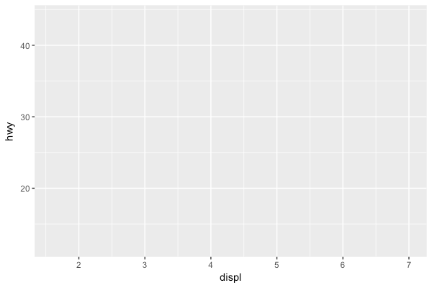
let’s create our “canvas”
# left
ggplot(data = mpg)
# right
ggplot(data = mpg, aes(x = displ, y = hwy))

Slide 9
geoms
geom_abline | geom_histogram
geom_bar | geom_jitter
geom_bin2d | geom_label
geom_blank | geom_map
geom_boxplot | geom_path
geom_contour | geom_point
geom_count | geom_polygon
geom_hex | geom_quantile
geom_crossbar | geom_raster
geom_density | geom_ribbon
geom_density_2d | geom_rug
geom_dotplot | geom_segment
geom_errorharh | geom_smooth
geom_freqpoly | geom_violin

Slide 10
lets add “geoms”
geom_abline | geom_histogram
geom_bar | geom_jitter
geom_bin2d | geom_label
geom_blank | geom_map
geom_boxplot | geom_path
geom_contour | geom_point
geom_count | geom_polygon
geom_hex | geom_quantile
geom_crossbar | geom_raster
geom_density | geom_ribbon
geom_density_2d | geom_rug
geom_dotplot | geom_segment
geom_errorharh | geom_smooth
geom_freqpoly | geom_violin
We display data with geometric shapes
~ 30 built-in geoms (with many more offered by other pkgs)
Type geom_ + tab in the console

Slide 11
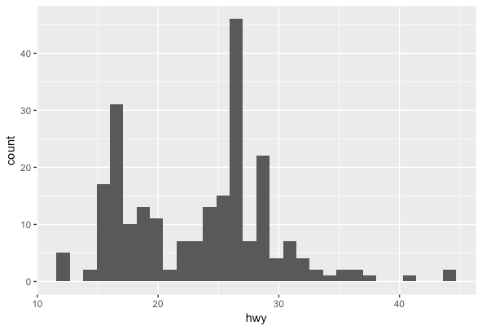
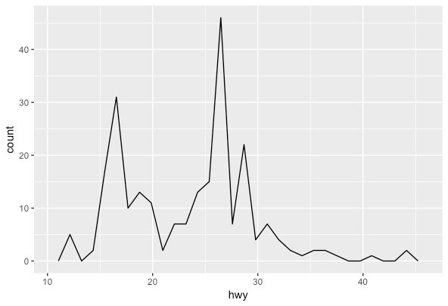
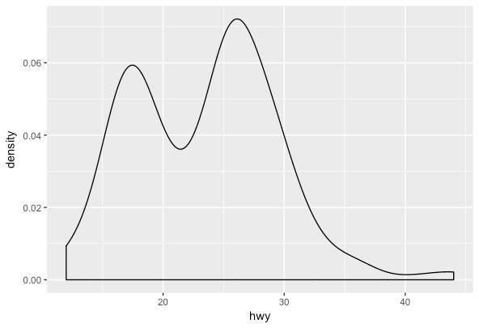
univariate geoms
geom_abline | geom_histogram
geom_bar | geom_jitter
geom_bin2d | geom_label
geom_blank | geom_map
geom_boxplot | geom_path
geom_contour | geom_point
geom_count | geom_polygon
geom_hex | geom_quantile
geom_crossbar | geom_raster
geom_density | geom_ribbon
geom_density_2d | geom_rug
geom_dotplot | geom_segment
geom_errorharh | geom_smooth
geom_freqpoly | geom_violin
ggplot(data = mpg, aes(x = hwy)) +
geom_histogram()
ggplot(data = mpg, aes(x = hwy)) +
geom_freqpoly()
ggplot(data = mpg, aes(x = hwy)) +
geom_density()

Slide 12
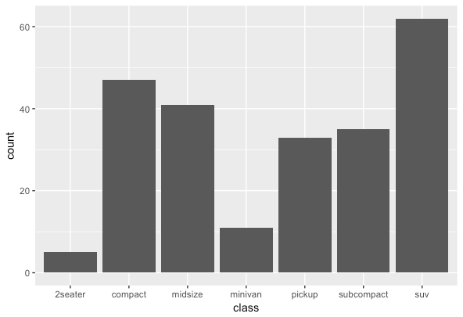
univariate geoms
geom_abline | geom_histogram
geom_bar | geom_jitter
geom_bin2d | geom_label
geom_blank | geom_map
geom_boxplot | geom_path
geom_contour | geom_point
geom_count | geom_polygon
geom_hex | geom_quantile
geom_crossbar | geom_raster
geom_density | geom_ribbon
geom_density_2d | geom_rug
geom_dotplot | geom_segment
geom_errorharh | geom_smooth
geom_freqpoly | geom_violin
ggplot(data = mpg, aes(x = class)) +
geom_bar()

Slide 13
univariate geoms
geom_abline | geom_histogram
geom_bar | geom_jitter
geom_bin2d | geom_label
geom_blank | geom_map
geom_boxplot | geom_path
geom_contour | geom_point
geom_count | geom_polygon
geom_hex | geom_quantile
geom_crossbar | geom_raster
geom_density | geom_ribbon
geom_density_2d | geom_rug
geom_dotplot | geom_segment
geom_errorharh | geom_smooth
geom_freqpoly | geom_violin
ggplot(data = mpg, aes(x = class)) +
geom_bar()
This is called an aesthetic mapping argument
Every geom requires a mapping argument
Some geoms require just one (x variable)
While other geoms require two (x & y variable)

Slide 14
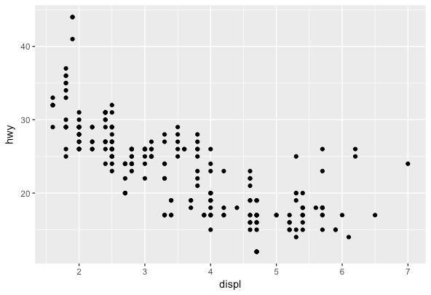
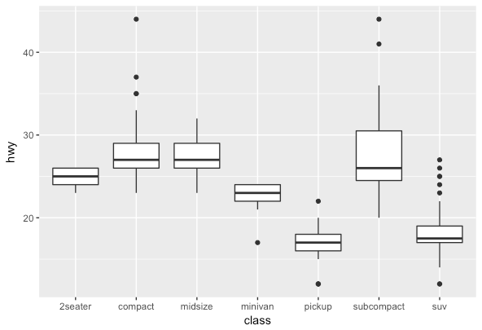
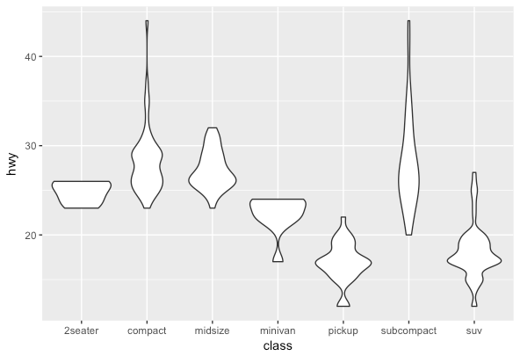
Bivariate geoms
geom_abline | geom_histogram
geom_bar | geom_jitter
geom_bin2d | geom_label
geom_blank | geom_map
geom_boxplot | geom_path
geom_contour | geom_point
geom_count | geom_polygon
geom_hex | geom_quantile
geom_crossbar | geom_raster
geom_density | geom_ribbon
geom_density_2d | geom_rug
geom_dotplot | geom_segment
geom_errorharh | geom_smooth
geom_freqpoly | geom_violin
ggplot(data = mpg, aes(x = displ, y = hwy)) +
geom_point()
ggplot(data = mpg, aes(x = class, y = hwy)) +
geom_boxplot()
ggplot(data = mpg, aes(x = class, y = hwy)) +
geom_violin()

Slide 15
Your turn!
Create a chart that illustrates the distribution of the cty variable
Create a chart that shows the number of observations for each manufacturer
Create a scatter plot of cty vs displ

Slide 16
Solution
# distribution of cty variable
ggplot(data = mpg, aes(x = cty)) +
geom_histogram()
# number of observations for each manufacturer
ggplot(data = mpg, aes(x = manufacturer)) +
geom_bar()
# scatter plot for cty vs displ
ggplot(data = mpg, aes(x = displ, y = cty)) +
geom_point()

Slide 17
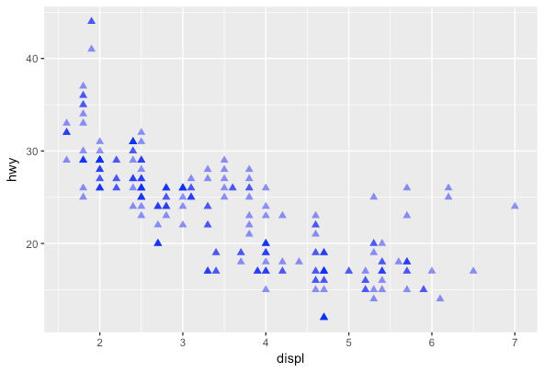
non-mapping aesthetics
ggplot(data = mpg, aes(x = displ, y = hwy)) +
geom_point(color = "blue", size = 2, shape = 17, alpha = .5)
We can also change other visual aesthetics in our graphics
color
size
shape (0-25 ?pch)
opacity
Lots of color and shape options; just google and you’ll find plenty of references

Slide 18
non-mapping aesthetics
ggplot(data = mpg, aes(x = displ, y = hwy)) +
geom_point(color = "blue", size = 2, shape = 17, alpha = .5)
We can also change other visual aesthetics in our graphics
color
size
sh△pe
opacity
Why are some points darker than others?
Try geom_jitter in place of geom_point
What do you think geom_jitter does?

Slide 19
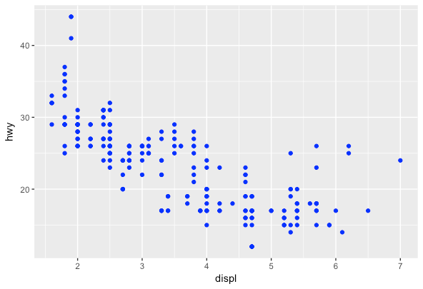
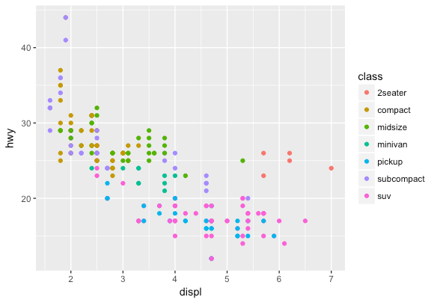
adding a 3rd dimension
ggplot(data = mpg, aes(x = displ, y = hwy)) +
geom_point(color = "blue")
By moving the color argument to within aes(), we can map
a 3rd variable to our plot
ggplot(data = mpg, aes(x = displ, y = hwy, color = class)) +
geom_point()

Slide 20
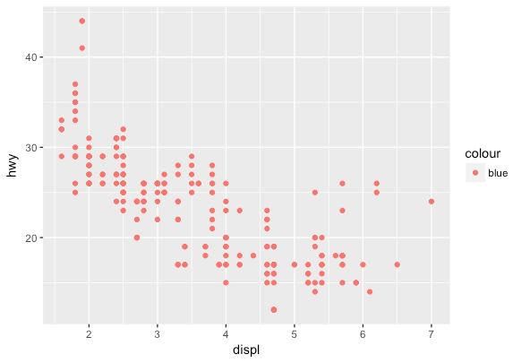
adding a 3rd dimension
A common error…what happened???
ggplot(data = mpg, aes(x = displ, y = hwy, color = “blue”)) +
geom_point()

Slide 21
Your turn!
Which variables in mpg are categorical? Which variables are continuous? (Hint: type ?mpg to read the documentation for the dataset). How can you see this information when you run mpg?
Map a continuous variable to color, size, and shape. How do these aesthetics behave differently for categorical vs. continuous variables?
What happens if you map the same variable to multiple aesthetics?
What does the stroke aesthetic do? What shapes does it work with? (Hint: use ?geom_point)
What happens if you map an aesthetic to something other than a variable name, like aes(colour = displ < 5)?

Slide 22
Solution
# 1. which variables are continuous vs categorical
?mpg
mpg
# A tibble: 234 × 11
manufacturer model displ year cyl trans drv cty hwy fl class
<chr> <chr> <dbl> <int> <int> <chr> <chr> <int> <int> <chr> <chr>
1 audi a4 1.8 1999 4 auto(l5) f 18 29 p compact
2 audi a4 1.8 1999 4 manual(m5) f 21 29 p compact
3 audi a4 2.0 2008 4 manual(m6) f 20 31 p compact
4 audi a4 2.0 2008 4 auto(av) f 21 30 p compact
5 audi a4 2.8 1999 6 auto(l5) f 16 26 p compact
6 audi a4 2.8 1999 6 manual(m5) f 18 26 p compact
7 audi a4 3.1 2008 6 auto(av) f 18 27 p compact
8 audi a4 quattro 1.8 1999 4 manual(m5) 4 18 26 p compact
9 audi a4 quattro 1.8 1999 4 auto(l5) 4 16 25 p compact
10 audi a4 quattro 2.0 2008 4 manual(m6) 4 20 28 p compact
# ... with 224 more rows

Slide 23
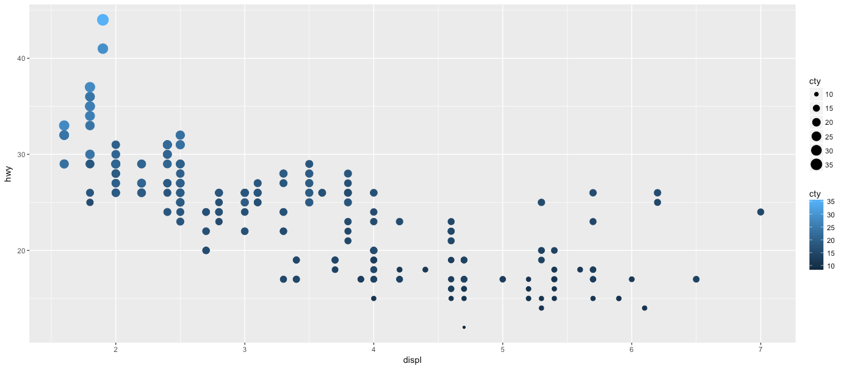
Solution
# 2. Map a continuous variable to color, size, and shape. How do these aesthetics behave
# differently for categorical vs. continuous variables?
ggplot(mpg, aes(displ, hwy, color = cty, size = cty)) +
geom_point()
Error: A continuous variable can not be mapped to shape

Slide 24
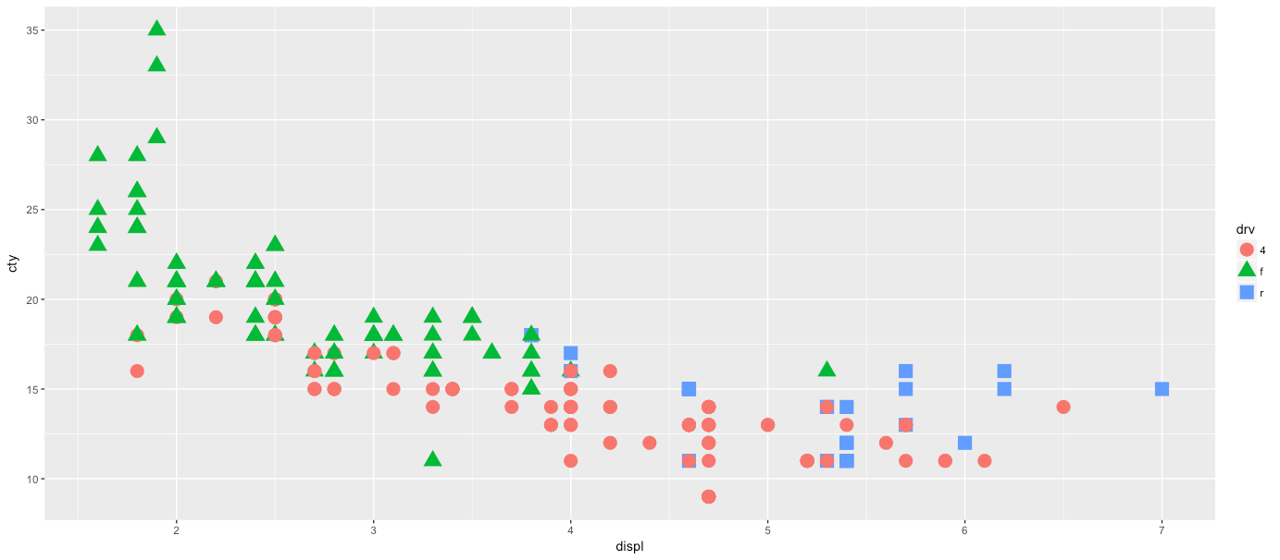
Solution
# 3. What happens if you map the same variable to multiple aesthetics?
ggplot(mpg, aes(displ, cty, color = drv, shape = drv)) +
geom_point()

Slide 25
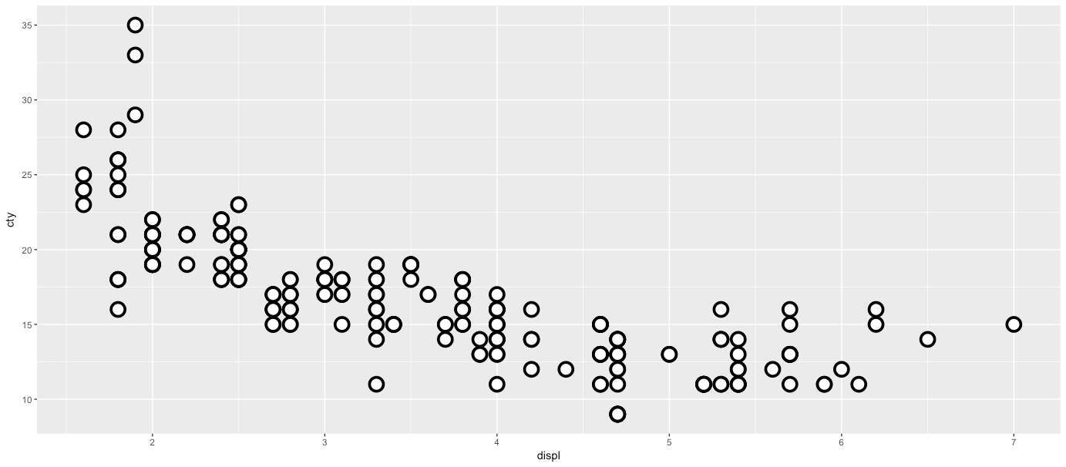
Solution
# 4. What does the stroke aesthetic do? What shapes does it work with?
ggplot(mpg, aes(displ, cty)) +
geom_point(shape = 21, colour = "black", fill = "white", size = 5, stroke = 2)

Slide 26
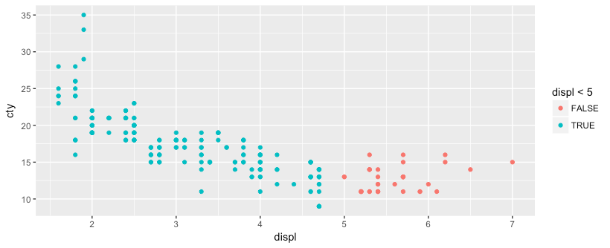
Solution
# 5. What happens if you map an aesthetic to something other than a variable name, like
# aes(colour = displ < 5)
ggplot(mpg, aes(displ, cty, color = displ < 5)) +
geom_point()

Slide 27
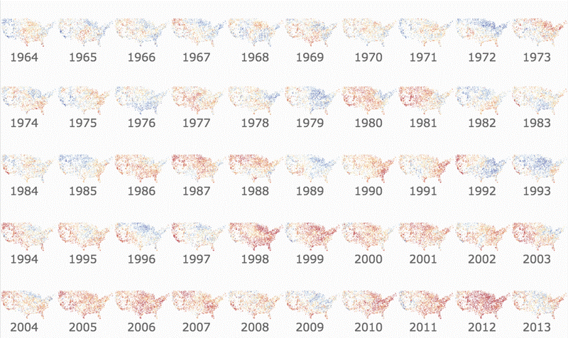
facets

Slide 28
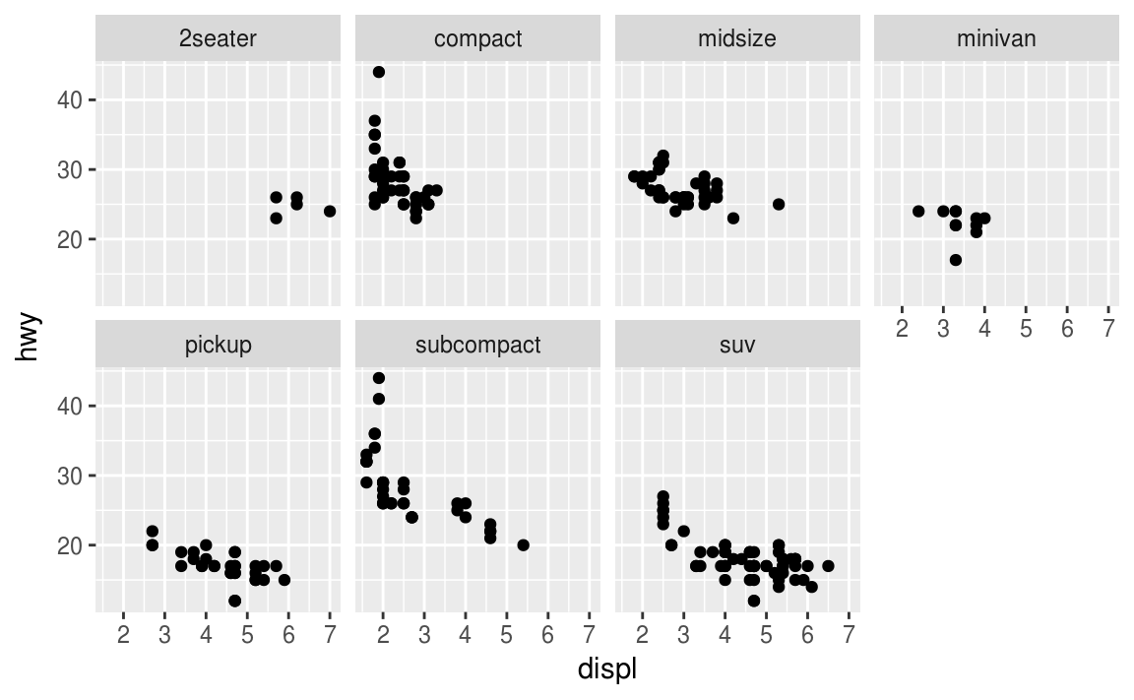
facets = small multiples
The facet functions provide a simple way to create small multiples
facet_wrap: primarily used to create small multiples based on a single variable
facet_grid: primarily used to create a small multiples grid based on two variables
ggplot(data = mpg, aes(x = displ, y = hwy)) +
geom_point() +
facet_wrap(~ class, nrow = 2)

Slide 29
facets = small multiples
The facet functions provide a simple way to create small multiples
facet_wrap: primarily used to create small multiples based on a single variable
facet_grid: primarily used to create a small multiples grid based on two variables
ggplot(data = mpg, aes(x = displ, y = hwy)) +
geom_point() +
facet_wrap(~ class, nrow = 2)
use nrow or ncol to specify dimensions
?facet_wrap to see other arguments to control the output

Slide 30
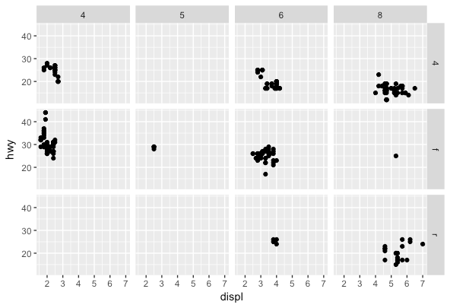
facets = small multiples
The facet functions provide a simple way to create small multiples
facet_wrap: primarily used to create small multiples based on a single variable
facet_grid: primarily used to create a small multiples grid based on two variables
ggplot(data = mpg, aes(x = displ, y = hwy)) +
geom_point() +
facet_grid(drv ~ cyl)

Slide 31
Your turn!
Create a scatter plot of displ vs cty facetted by year.
Create a scatter plot of displ vs cty facetted by year and cyl.
How does placement within facet_grid(cyl ~ year) affect the output?
How does facet_grid(cyl ~ year) differ from facet_grid(~ year + cyl)?
What do the scales and space arguments do?

Slide 32
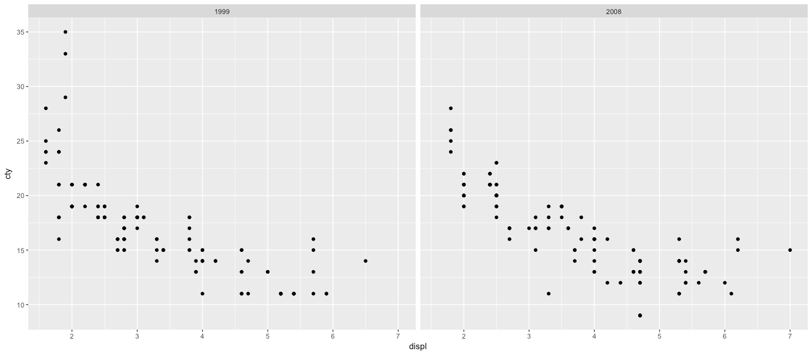
Solution
# 1. Create a scatter plot of displ vs cty facetted by year.
ggplot(mpg, aes(displ, cty)) +
geom_point() +
facet_wrap(~ year)

Slide 33
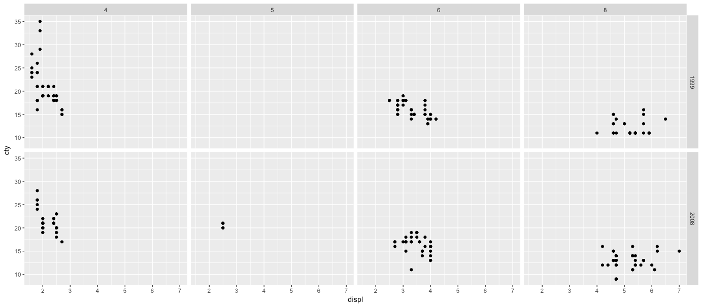
Solution
# 2. Create a scatter plot of displ vs cty facetted by year and cyl
ggplot(mpg, aes(displ, cty)) +
geom_point() +
facet_grid(year ~ cyl)

Slide 34
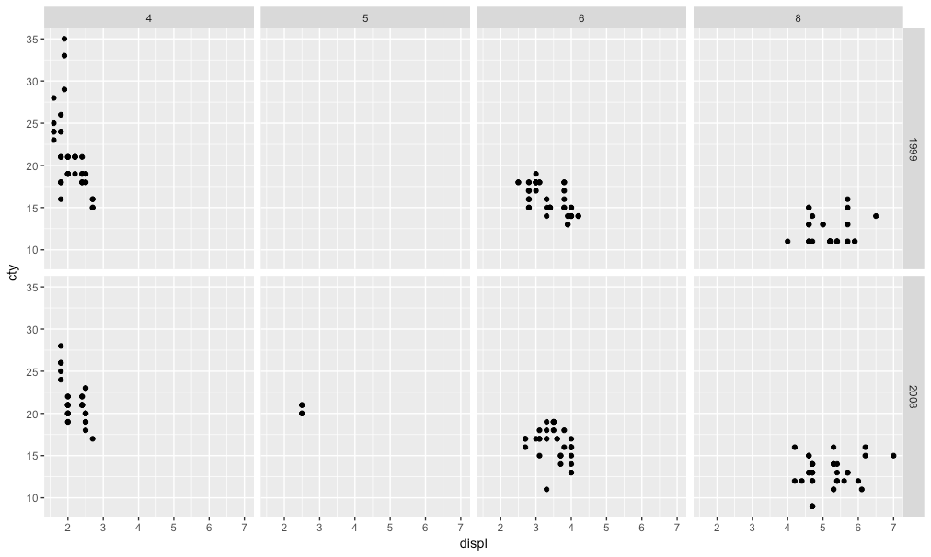
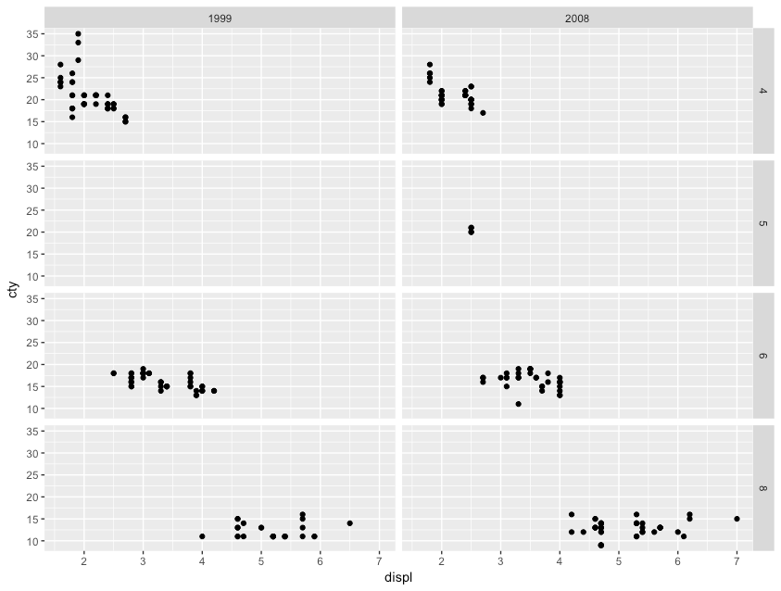
Solution
# 3. How does placement within facet_grid(cyl ~ year) affect the output?
facet_grid(year ~ cyl)
facet_grid(cyl ~ year)

Slide 35
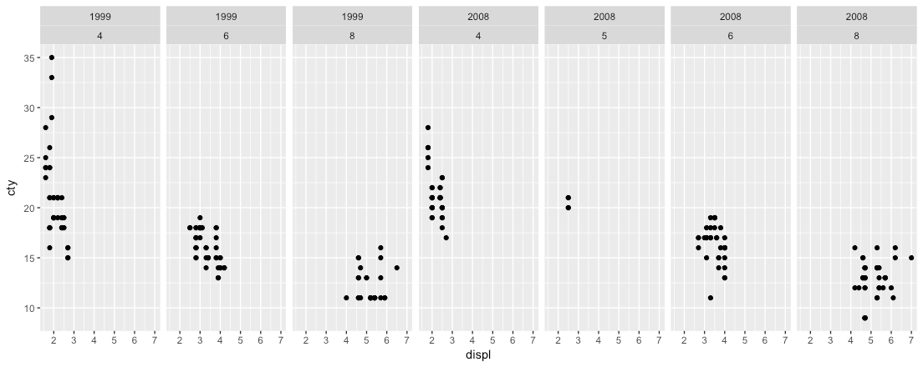
Solution
# 4. How does facet_grid(cyl ~ year) differ from facet_grid(~ year + cyl)?
ggplot(mpg, aes(displ, cty)) +
geom_point() +
facet_grid(~ year + cyl)

Slide 36
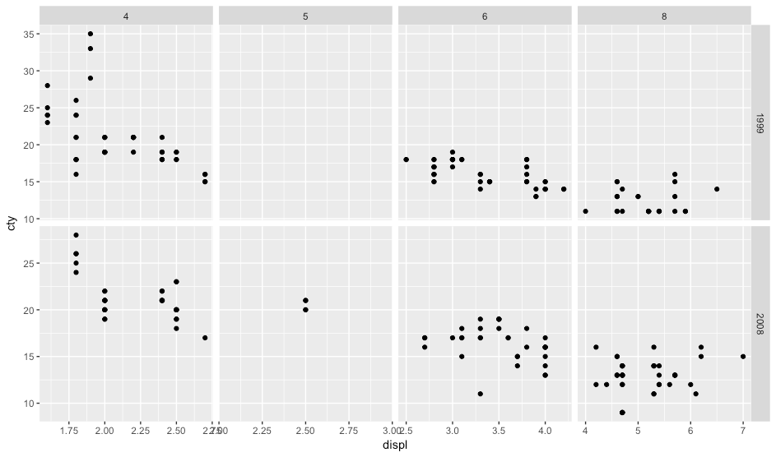
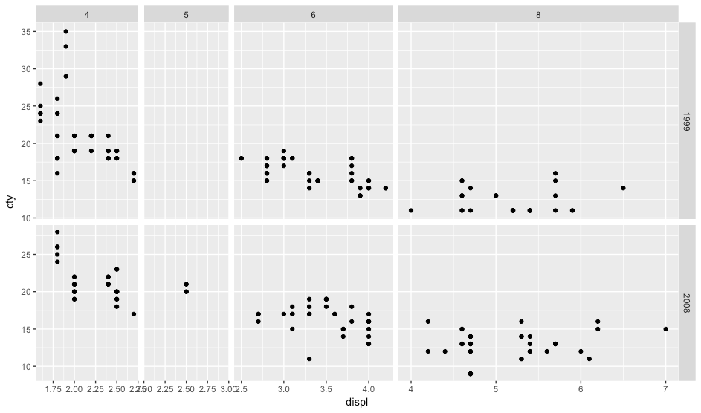
Solution
# 5. What do the scales and space arguments do
ggplot(mpg, aes(displ, cty)) +
geom_point() +
facet_grid(year ~ cyl, scales = "free")
ggplot(mpg, aes(displ, cty)) +
geom_point() +
facet_grid(year ~ cyl, scales = "free", space = "free")

Slide 37
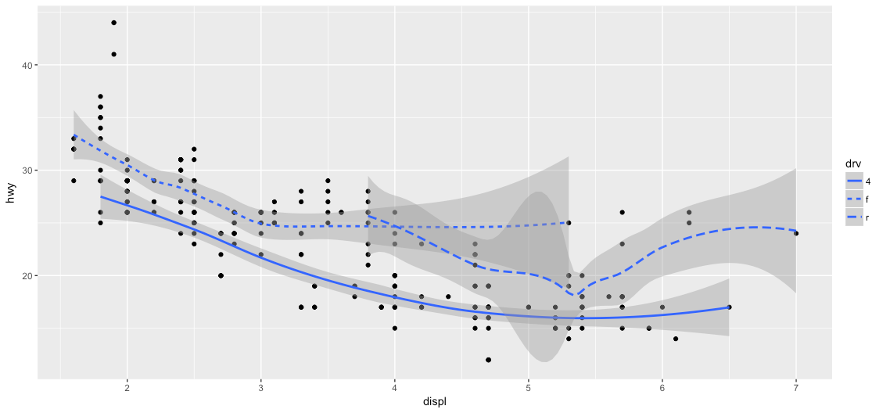
overplotting

Slide 38
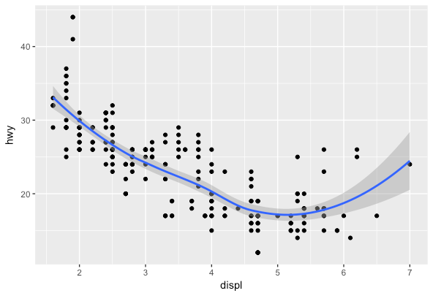
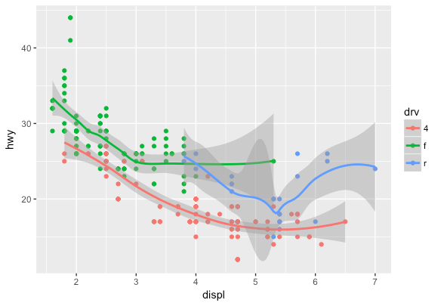
layering helps display patterns
mpg %>%
ggplot(aes(x = displ, y = hwy)) +
geom_point() +
geom_smooth()
mpg %>%
ggplot(aes(x = displ, y = hwy, color = drv)) +
geom_point() +
geom_smooth()

Slide 39
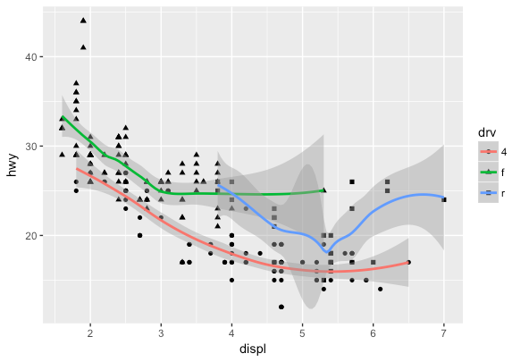
layering helps display patterns
mpg %>%
ggplot(aes(x = displ, y = hwy, color = drv)) +
geom_point() +
geom_smooth()
mpg %>%
ggplot(aes(x = displ, y = hwy)) +
geom_point(aes(shape = drv)) +
geom_smooth(aes(color = drv))
aes mapping can be done in ggplot() or geom_xx()

Slide 40
layering helps id abnormalities
mpg %>%
ggplot(aes(x = displ, y = hwy)) +
geom_point() +
geom_smooth()
What’s driving this upward swing?

Slide 41
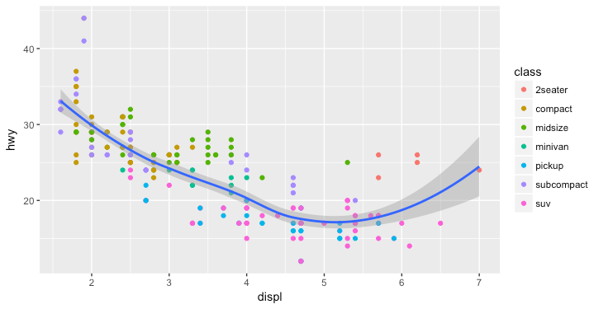
layering helps id abnormalities
mpg %>%
ggplot(aes(x = displ, y = hwy)) +
geom_point(aes(color = class)) +
geom_smooth()
Looks like it could be the 2 seaters but we need to verify

Slide 42
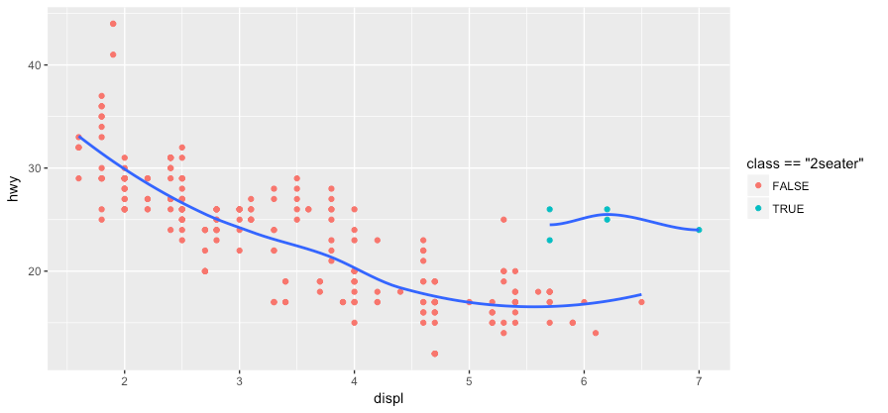
layering helps id abnormalities
mpg %>%
ggplot(aes(x = displ, y = hwy)) +
geom_point(aes(color = class == "2seater")) +
geom_smooth(data = filter(mpg, class == "2seater"), se = FALSE) +
geom_smooth(data = filter(mpg, class != "2seater"), se = FALSE)

Slide 43
Your turn!
Over plot:
ggplot(data = mpg, aes(x = class, y = hwy)) +
geom_boxplot()
with geom_jitter(width = .2, alpha = .5)
If you add geom_rug() to
ggplot(data = mpg, aes(x = displ, y = cty)) +
geom_smooth()
what does this tell you?

Slide 44
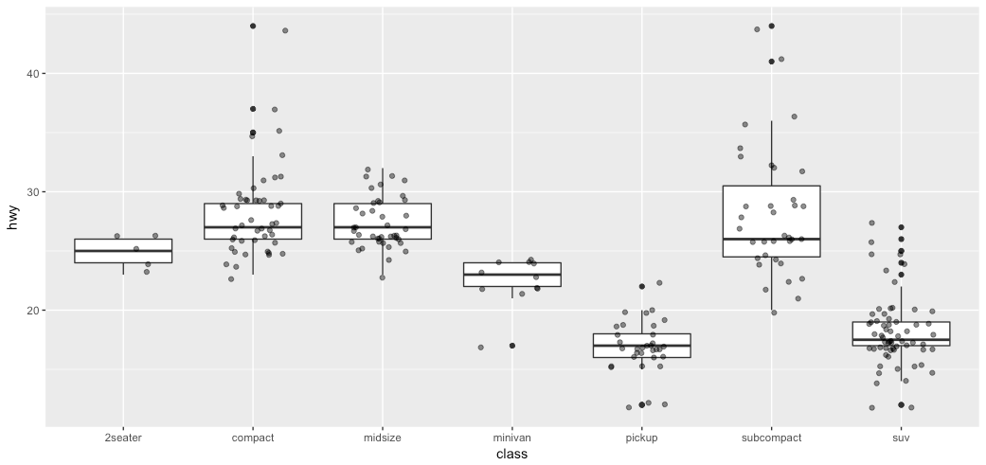
Solution
# 1. Overplot boxplot with jitter
ggplot(mpg, aes(class, hwy)) +
geom_boxplot() +
geom_jitter(width = .25, alpha = .5)

Slide 45
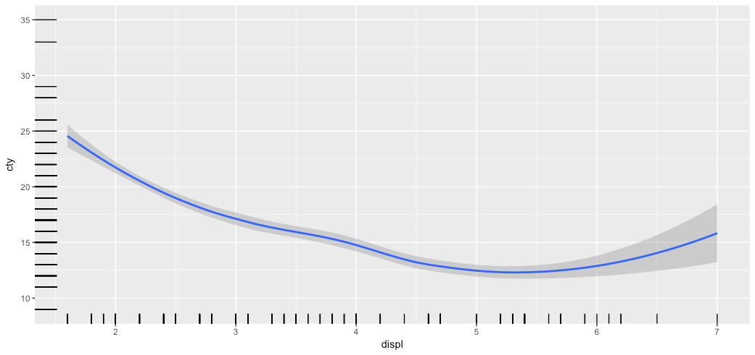
Solution
# 2. add geom_rug to smoother
ggplot(mpg, aes(displ, cty)) +
geom_smooth() +
geom_rug()

Slide 46
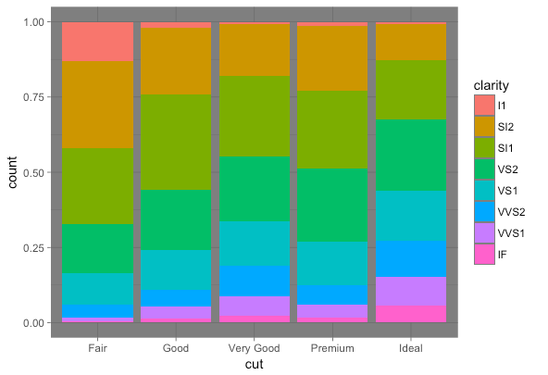
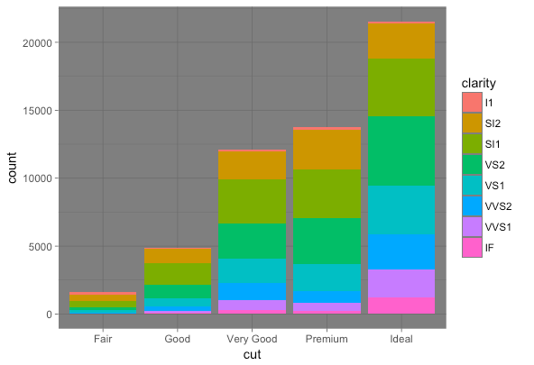
Positioning

Slide 47
bar charts
All geoms have a position argument but rarely will you need to adjust it
geom_bar and a few others benefit from its use though:
position = “stack” (default)
position = “fill”
position = “dodge”

Slide 48
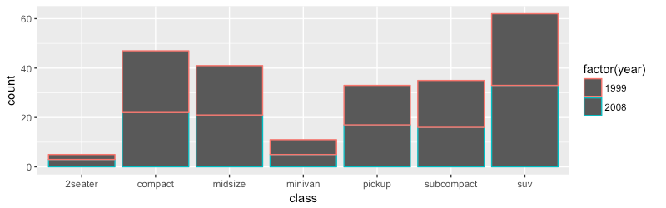
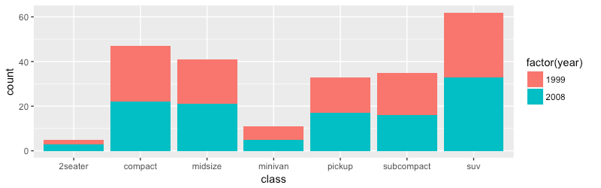
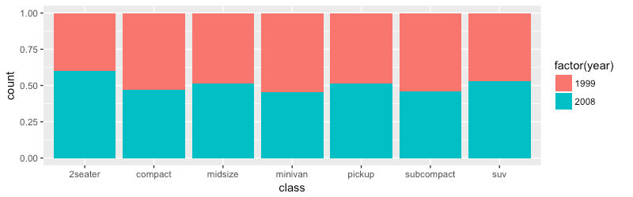
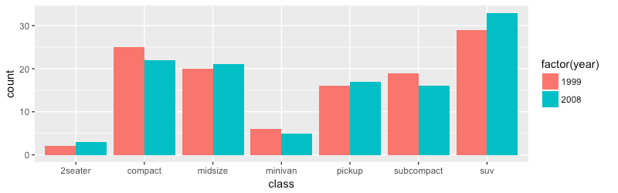
bar charts
ggplot(data = mpg, aes(class, color = factor(year))) +
geom_bar()
ggplot(data = mpg, aes(class, fill = factor(year))) +
geom_bar()
ggplot(data = mpg, aes(class, fill = factor(year))) +
geom_bar(position = “fill”)
ggplot(data = mpg, aes(class, fill = factor(year))) +
geom_bar(position = “dodge”)

Slide 49
Your turn!
Use geom_bar and the different position arguments to assess how the cyl variable is distributed within each class.

Slide 50
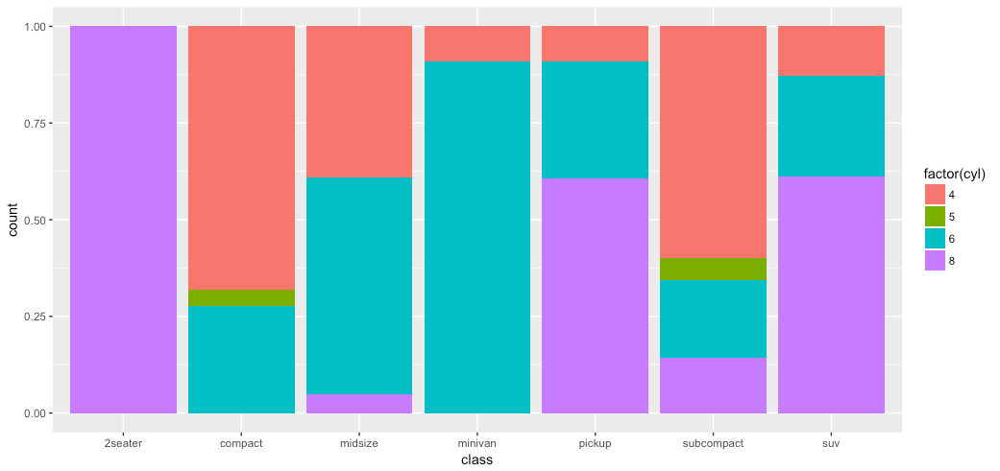
Solution
# One potential solution
ggplot(mpg, aes(class, fill = factor(cyl))) +
geom_bar(position = "fill")

Slide 51
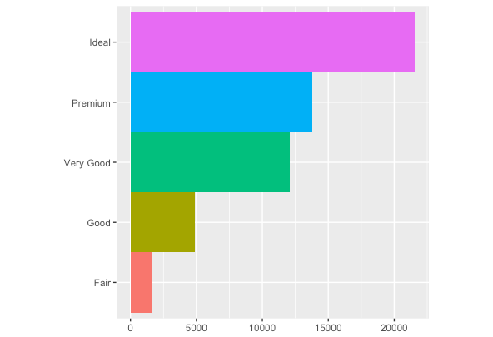
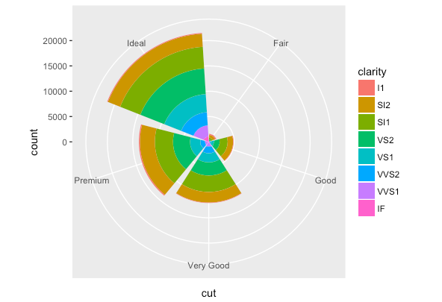
Coordinate system

Slide 52
manipulating your coordinates
There are many options to manipulate and adjust the coordinate system but some basic ones include:

Slide 53
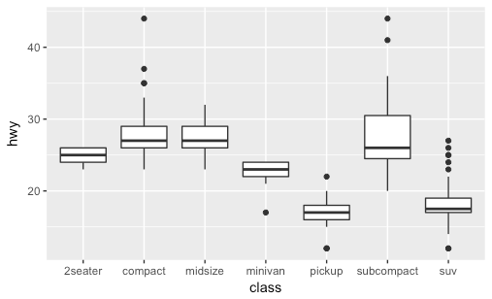
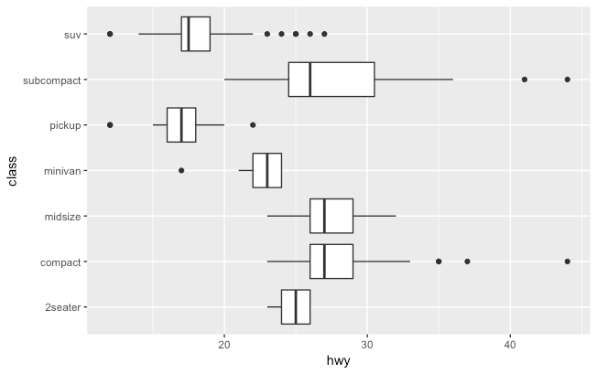
manipulating your coordinates
There are many options to manipulate and adjust the coordinate system but some basic ones include:
flipping the coordinates
# top
ggplot(data = mpg, aes(x = class, y = hwy)) +
geom_boxplot()
# bottom
ggplot(data = mpg, aes(x = class, y = hwy)) +
geom_boxplot() +
coord_flip()

Slide 54
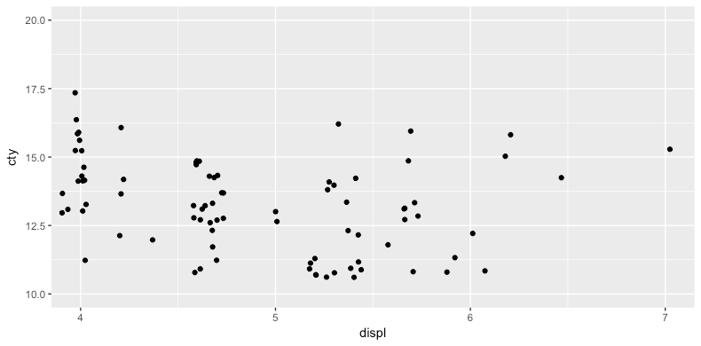
manipulating your coordinates
There are many options to manipulate and adjust the coordinate system but some basic ones include:
zooming in or out
ggplot(data = mpg, aes(x = displ, y = cty)) +
geom_jitter() +
coord_cartesian(xlim = c(4, 7), ylim = c(10, 20))

Slide 55
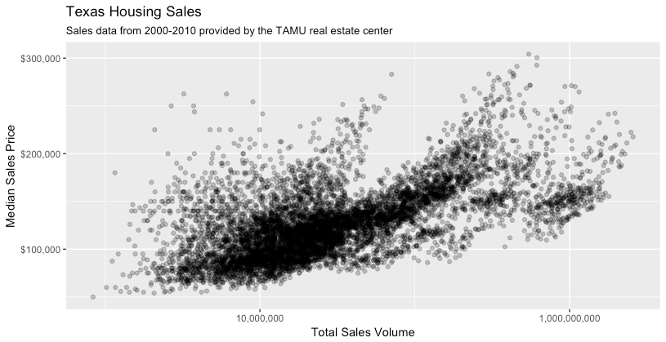
manipulating your coordinates
There are many options to manipulate and adjust the coordinate system but some basic ones include:
formatting axes and labels
ggplot(data = txhousing, aes(x = volume, y = median)) +
geom_point(alpha = .25) +
scale_y_continuous(name = "Median Sales Price", labels = scales::dollar) +
scale_x_log10(name = "Total Sales Volume", labels = scales::comma) +
ggtitle("Texas Housing Sales",
subtitle = "Sales data from 2000-2010 provided by the TAMU real estate center")

Slide 56
manipulating your coordinates
There are many options to manipulate and adjust the coordinate system but some basic ones include:
formatting axes and labels
ggplot(data = txhousing, aes(x = volume, y = median)) +
geom_point(alpha = .25) +
scale_y_continuous(name = "Median Sales Price", labels = scales::dollar) +
scale_x_log10(name = "Total Sales Volume", labels = scales::comma) +
ggtitle("Texas Housing Sales",
subtitle = "Sales data from 2000-2010 provided by the TAMU real estate center")
This is what I expect your project visualizations to look like!

Slide 57

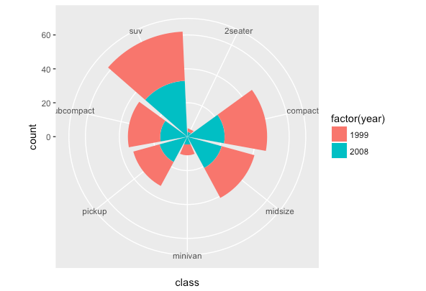
manipulating your coordinates
There are many options to manipulate and adjust the coordinate system but some basic ones include:
creating pie charts
ggplot(data = mpg, aes(class, fill = factor(year))) +
geom_bar() +
coord_polar()

Slide 58

Your turn!
How close can you get to re-creating this?

Slide 59

Solution
mpg %>%
ggplot(aes(x = class, fill = factor(cyl))) +
geom_bar(position = "fill") +
scale_y_continuous(name = "Percent", labels = scales::percent) +
coord_flip()

Slide 60

so little time!

Slide 61
see layering in action
https://rpubs.com/bradleyboehmke/weather_graphic

Slide 62


learn more

Slide 63

Leverage help as you’re learning
Help >> Cheatsheets >> Data Visualization with ggplot2

Slide 64

what to remember

Slide 65
functions to remember
Operator/Function | Description
ggplot() | Initializes a ggplot object (creates the blank canvas)
aes() | Creates aesthetic mappings
geom_xx | Geometric shapes to plot the data
color, shape, size, alpha, etc | Aesthetic parameters
facet_wrap, facet_grid | Create small multiples
position | Position argument (primarily used with bar charts)
coord_xx | Functions to adjust the coordinate system
scale_xx | Functions to adjust x and y axis

Slide 66
important
This aligns to standards 4.2, 4.3, 4.5.

Slide 67
Homework4
Make a one-page brief report contains:
A title
Only one visualization, make sure it’s nicely presented
No more than two paragraphs of statement (what’s the data you used, what phenomenon or observation you want to present and how this visualization support that)
Submit the RPub URL via Canvas,
Due NOV 15, 2020 11:59PM

Slide 68
Coding exercise
Another guideline for your final project
Due: NOV 10, 2020 11:59PM
Send your brief plan via slack.

Slide 69

15 minute break

